Slide 1





Home Credit Default Risk Detection
An Application of Big Data & Artificial Intelligence
Group Name: Map Reducers
Group Members: Sahitya Angara, Akshay Havalgi, Mit Patel, Shashank Manu Rao, Vivek Sivalingam, Nicholas Summers

Slide 2






Hello!
Sahitya A
Nick S
Akshay H
We are the Map Reducers.
A team of analysts inspired and driven by the infinite potential of Data Science.
Vivek S
Mit P
Shashank R

Slide 3
What is Home Credit Default Risk?
Home Credit risk is the probability of a client not being able pay back a housing loan on time
This is a problem of high importance in the housing sector as well as the financial sector
Why is credit risk important?
Credit defaults affect the economy (eg: 2008 recession)
Prevent lenders from lending to certain borrowers
Prevent borrowers from borrowing too much

Slide 4

16.1 Trillion U D
Whoa! That’s a lot of money, is this good?

Slide 5


The Impact of Home Credit Risk
How does this affect everyone?

Slide 6

Damage to Various Stakeholders
Borrowers can lose their assets when they default on a loan. They can also declare bankruptcy.
Borrowers can have their wages garnished.
Lending institutions can lose their financial asset.
Lending institutions can become insolvent.

Slide 7

Our Approach
Our Data
- Where: Kaggle
- What: Applicant
- Why: The large feature set; It was a BIG DATA set - Good potential for EDA, modeling, and extracting practical insights
Data ETL
- Kaggle → Google Colab
- Joined datasets based on FKs
- Performed EDA
- Identified and eliminated outliers
- Feature Engineering
- Loaded in G Drive
Modeling
- Model selection
- Regressions
- Clustering
- Neural Nets
- Boosting

Slide 8
Our process is simple
Extract Transform Load
Clean and transform messy data into a nice flat structure, ready for data analysis
1
Model Building
Build predictive models using tuned hyperparameters to evaluate metrics
2
Insights
Gain valuable insights that drive business decisions
3

Slide 9
Exploratory Data Analysis

Slide 10
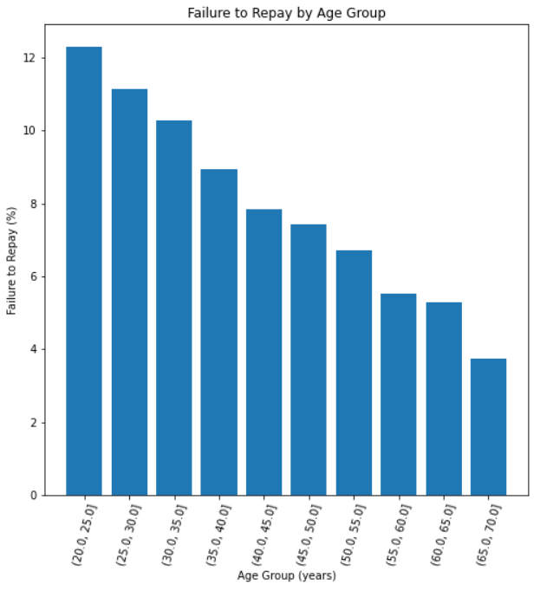
Effect of age on repayment

Slide 11
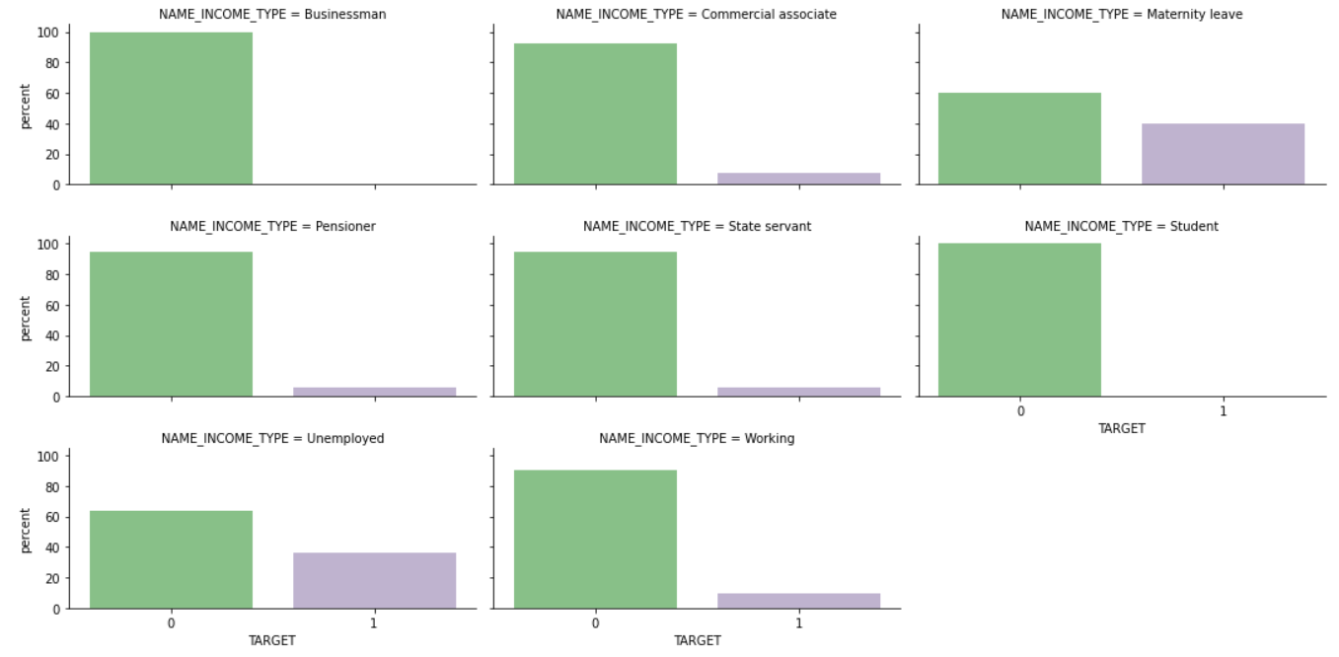
Influence of Income Type on Credit Risk

Slide 12
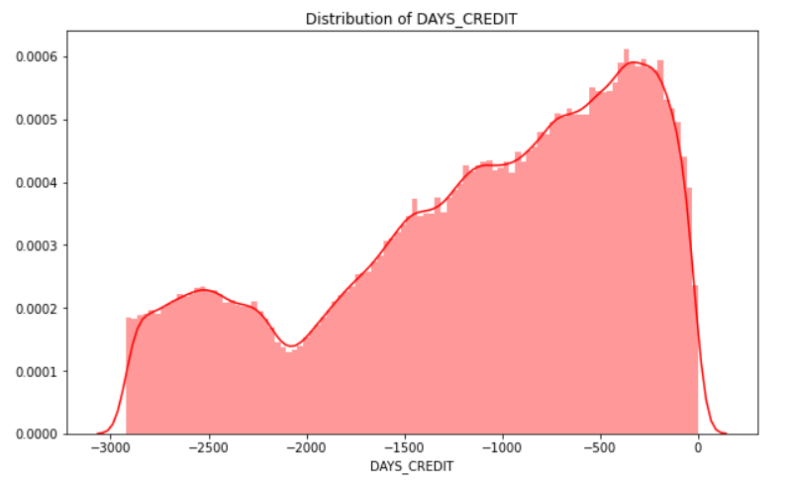
Distribution of Duration between Credit Loan Application and Home Credit Application

Slide 13


Extract
Transform
Load

Slide 14

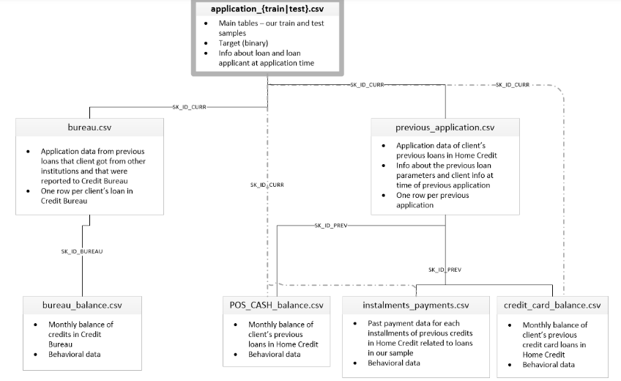
Data Structure

Slide 15
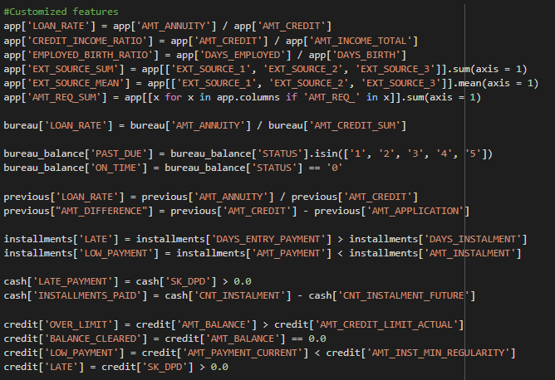
Manual Feature Engineering

Slide 16




Machine Learning
Using machine learning to detect home credit default risk and derive insights to drive business decisions

Slide 17
Which to choose ?
Model
Logistic Regression
Random Forest
Conv.
Neural Network
K-Means Clustering
XGBoost
Accuracy
55.7%
70.3%
69.0%
68.5%
70.5%
True Positive Rate
61.3%
69.9%
70.3%
70.1%
71.2%

Slide 18

Model Selection
Best Models
(Accuracy; TPR)
Logistic Regression
XGBoost
Key Constraints
False Negative - Undesirable (mistaking defaulters for non-defaulters)
True Positives & Accuracy: Most important factors for consideration
And the winner is..
XGBoost
Why: Low chances of overfitting, automatic feature selection

Slide 19
So what ?!
Notes:
Now that we have our models in place, it's time to ask the important question: So what?
Moving on to our findings.

Slide 20
Our Findings
The age of the borrower can impact their probability of default on a loan; Young people tend to default at higher rates.
Accurate credit risk assessments can protect the financial well-being of both borrowers and lenders as well as the overall health of the economy.
Notes:
Based on the analysis we have performed, we found that the age of borrowers can impact the probability of them defaulting on a loan. For example, Young people tend to default at higher rates than older people.
We can decrease the loan default by accurate credit risk assessments, which is useful for both the lenders and the borrowers.
Young people tend to default at higher rates.

Slide 21
Who would benefit from this analysis?
Financial Services Sector
The total mortgage debt outstanding in the U.S. amounted to approximately 16.01 trillion U.S. dollars in 2019. Defaults on these could devastate a bank and the economy.
https://www.statista.com/statistics/274636/combined-sum-of-all-holders-of-mortgage-debt-outstanding-in-the-us/
The Government
The U.S Federal Government wants to ensure that banks loan responsibly in order to prevent another economic crisis like we experienced in 2008.
The Consumer
If financial institutions improve their credit risk assessments, borrowers will only be able to borrow money that they can pay back reasonably. This can prevent consumers from losing their homes due to foreclosure.
Notes:
Our project analysis has several use cases such as financial services sector, as we all know that Us has a huge mortgage debt of 16 trillion dollars, defaults on these loans can destruct the economy.
It is useful for the government to look after how banks are issuing loans to consumers, in order to prevent economic crisis.
It can be also be applied to the consumer domain, where borrowers can understand their requirement and their capacity to repay the loan, based on the existing source of income and other assets that they may have. This can prevent them from defaulting on a loan.

Slide 22

Thanks!
We'll be happy to answer any questions you may have!

